Slide 1
HTML

Slide 2
Web Development Technologies
HTML – Nouns
The structure of the document
CSS – Adjectives and adverbs
The appearance of the document
JavaScript and JQuery – Verbs
The behavior of the document

Slide 3
HTML
Hyper Text Markup Language
Markup languages are not procedural. They describe the document content
The languages consists of a set of descriptive tags
Another application (i.e. a browser) must interpret the tags and determine how to display the document

Slide 4
Tags
HTML tags are keywords surrounded by angle brackets
The tags come in pairs like <div> and </div> with an opening tag and a closing tag
The text between the opening and closing tags is called the content
Although some versions of HTML allow you to omit some closing tags, you should always include the closing tag
The tags along with their content are called elements
<p>This is some content.</p>

Slide 5
HTML Elements
<p>This is a paragraph element.</p>
Elements include everything from the opening tag to the closing tag. Even though the current version (HTML5) allows you to leave off the closing tag for some elements, it’s better not to because it can create difficulties for the browser.
<br />
Some elements don’t have content so having a separate closing tag doesn’t make much sense. In this case, including a / inside the tag is the proper way to close it.
<div><p>This is nested content.</p></div>
Elements can be nested within one another.
A more complete list of available tags can be found at many places on the web including w3schools.com
http://www.w3schools.com/html/default.asp

Slide 6
Block vs Inline elements
Block elements start and end with new lines by default (e.g. <h1>, <p>, <div>).
The <div> element is a block level element that is used to organize a document. Although the <div> element has no display properties itself, it is often used to organize the content of a document into sections.
Inline elements are displayed on the same line as the elements before and after (e.g. <b>, <td>, <a>, <img>,<span>).
The <span> element is similar to the <div> element in that it is used to organize documents and is used to style sections of a document.

Slide 7
Attributes
<a href="http://www.w3schools.com">This is a link</a>
Tags can include attributes within the opening tag that provide information for the browser. In the example above the href is an attribute of the <a> tag.
The values of attributes should always be in quotes, either double or single.
Two important attributes:
id – used to identify a specific element so that you can reference it in code or for styling (e.g. <div id=‘myDiv’>
class – used to identify a group of elements (e.g. <div class=“myDivs”>

Slide 8
HTML Document Format
Indicates the page is HTML version 5
<!DOCTYPE html>
<html>
<head>
</head> <body> <h1>My First Heading</h1> <p>My first paragraph.</p>
</body> </html>
The beauty of HTML was that it was implemented as plain text.
This means that HTML pages can be created very easily with inexpensive software and that they are transmitted over networks very easily.
Notes:
Head section is primarily used for metadata

Slide 9
Lists
<ul>
<li>List item 1</li>
<li>List item 2</li>
<li>List item 3</li>
</ul>
<ul>
<li><h2>List item 1</h2>List subitem 1</li>
<li>List item 2</li>
<li>List item 3</li>
</ul>

Slide 10
The <head> section
<!DOCTYPE html> <html> <head>
<meta charset="utf-8"> <title>Title of the document</title>
<meta name="author" content=“John Doe">
<link rel="stylesheet" type="text/css" href="mystyle.css">
<style type="text/css">body {background-color:yellow;}</style>
<script src="scripts/script_customer.js"></script> </head> <body> The content of the document...... </body> </html>
The <head> section of an HTML document is used to provide information to the browser to help it process the page and to provide information for applications like search engines.
Notes:
Title section is only visible portion of header

Slide 11
The <head> section
A number of tags are used in the <head> section:
<meta> - used to provide information not used to display the document but can be used by search engines, for example.
<meta name="author" content=“John Doe">
<meta charset="utf-8">
<title> - provides a title for the page.
<title>Title of the document</title>
<link> - used to link to external documents like CSS files.
<link rel="stylesheet" type="text/css" href="mystyle.css">
<style> - used to insert CSS into the HTML document.
<style type="text/css">body {background-color:yellow;}</style>
<script> - used to insert scripting code or to refer to external documents with scripting code
<script src="scripts/script_customer.js"></script>.

Slide 12
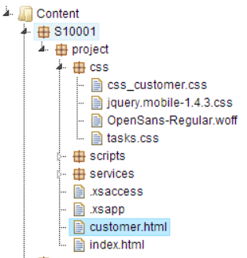
Relative Reference
References can be absolute:
http://server:port/S10001/project/customer.html
Absolute references include the full path including the server address.
References from within a web page can also be relative:
<link rel="stylesheet" type="text/css" href=“css/css_customer.css">
Relative to the folder of the web page.
<link rel="stylesheet" type="text/css" href=“../css/project/css_customer.css">
Relative to the parent folder of the web page.

Slide 13
Formatting
Although HTML includes a number of tags that can be used for formatting
Content (i.e. <strong>, <b>, <em>), it’s much better practice to use Cascading Style Sheets (CSS) so that the style information is kept separate from the document structure. This makes it much easier to maintain a web page.
<div id=“myDiv”>This content will be bold.</div>
#myDiv {
font-weight: bold;
}

Slide 14
Comments
You can insert comments in HTML documents using the <!– and -- > tags.
<!-- Write your comments here -->
It’s a good idea to insert comments in complex documents especially if others may be maintaining the page.

Slide 15
<html>
<body>
<div id=“page”>
<h1 id=“header”>List</h1>
<h2>Buy Groceries</h2>
<ul>
<li id=“one” class=“hot”>fresh figs</li>
<li id=“two” class=“hot”>pine nuts</li>
</ul>
<script src=“script/scripts.js”></script>
</div>
</body>
</html>

Slide 16
document
The div is a parent to h1, h2, etc. and h1, h2, etc. are children of the div
html
body
div
attribute
h1
attribute
h2
ul
script
attribute
text
text
li
attribute
li
attribute
h1, h2, etc. are siblings
text
text
Notes:
Hierarchy necessary to understand Jquery and javascript calls. Aurelia will allow us to not need intimate knowledge of these structures

Slide 17
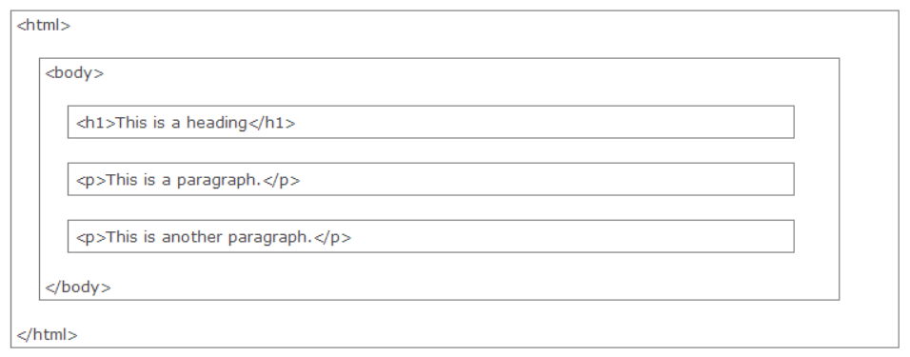
HTML Page Structure
HTML pages can be visualized as a group of rectangles, some nested within other rectangles. The overall structure forms a hierarchy called the Document Object Model (DOM)

